Slide 1
CIS 276: Introduction to Enterprise Web Development

Slide 2
Learning Outcomes
This presentation will...
Explore HTML tables

Slide 3
Tables
*To present traditional tabular material
*For buttons, calendars, etc.
*Do not overdo tables; can cause pages
to load more slowly
*Tables can be nested within tables

Slide 4
Basic Table Tags
<table>… </table> defining tag
<caption> … </caption> table title (by default,
displayed above data)
Note: Tag placement within code does
not alter its displayed position
<tr> … </tr> table row
<th> … </th> table header
<td> … </td> table data (a cell)

Slide 5
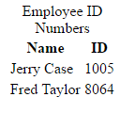
Basic Table Illustration
<table>
<caption>Employee ID Numbers </caption>
<tr>
<th>Name</th>
<th>ID</th>
</tr>
<tr>
<td>Jerry Case</td>
<td>1005</td>
</tr>
<tr>
<td>Fred Taylor</td>
<td>8064</td>
</tr>
</table>
On 2 lines because the caption is wider than the data

Slide 6
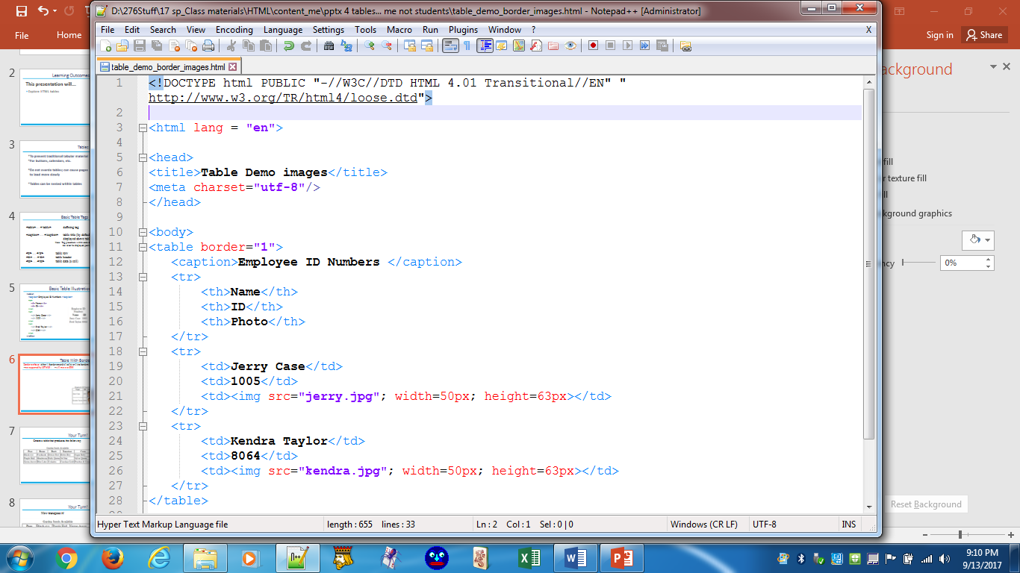
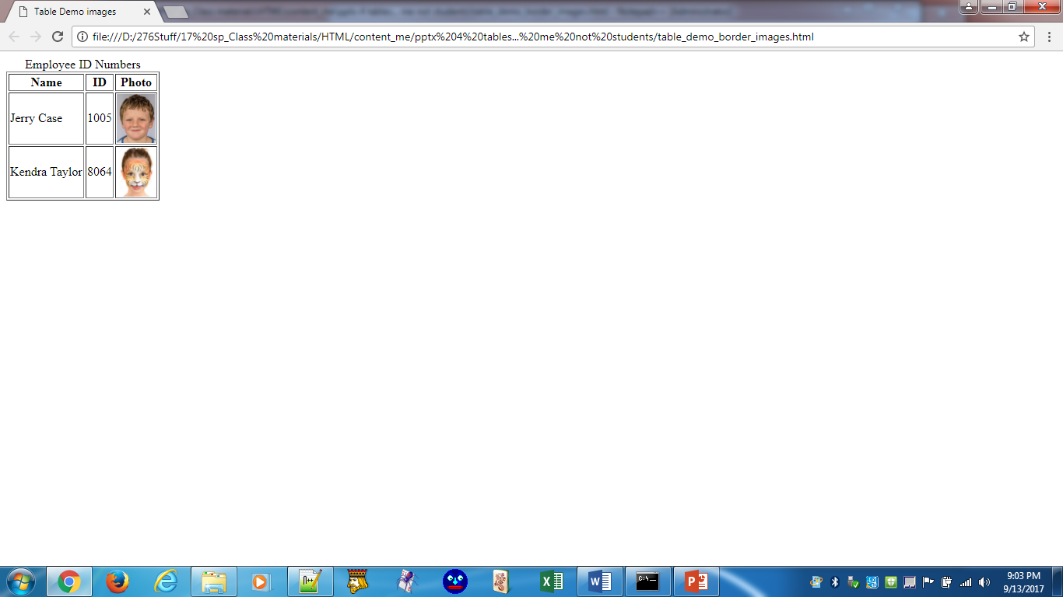
Table With Border
Border attribute: either 1 (border around all cells) or 0 (no borders)
--not supported by HTML5; --will move to CSS

Slide 7
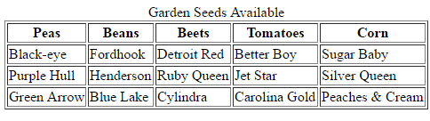
Your Turn!
Create a table that produces the following:

Slide 8
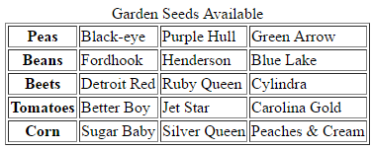
Your Turn!
Now transpose it!

Slide 9
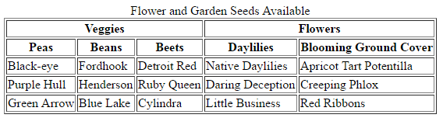
colspan Attribute
Remember, the border attribute will go the CSS
<table border="1">
<caption>Flower and Garden Seeds Available</caption>
<tr>
<th colspan = "3">Veggies</th>
<th colspan = "2">Flowers</th>
</tr>
…
</table>

Slide 10
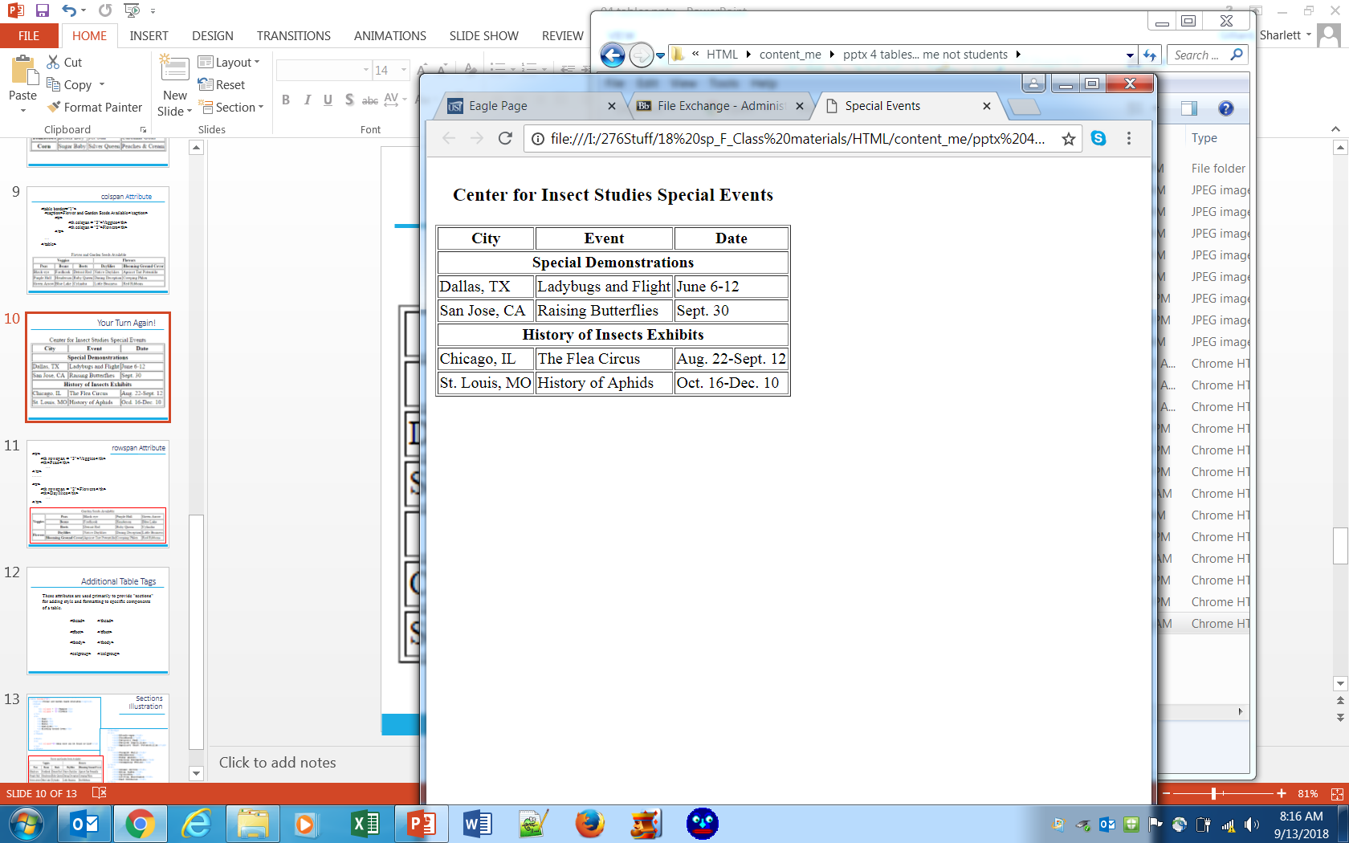
Your Turn Again!
Notes:
Caption is also a h3 level

Slide 11
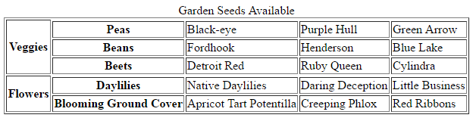
rowspan Attribute
<tr>
<th rowspan = "3">Veggies</th>
<th>Peas</th>
…
</tr>
……
<tr>
<th rowspan = "2">Flowers</th>
<th>Daylilies</th>
…
</tr>

Slide 12
Additional Table Tags
These attributes are used primarily to provide "sections" for adding style and formatting to specific components of a table.
<thead> </thead>
<tfoot> </tfoot>
<tbody> </tbody>
<colgroup> </colgroup>

Slide 13
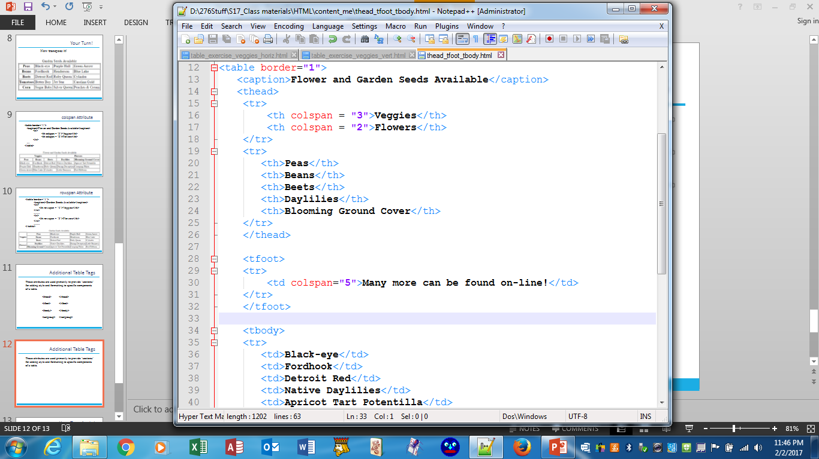
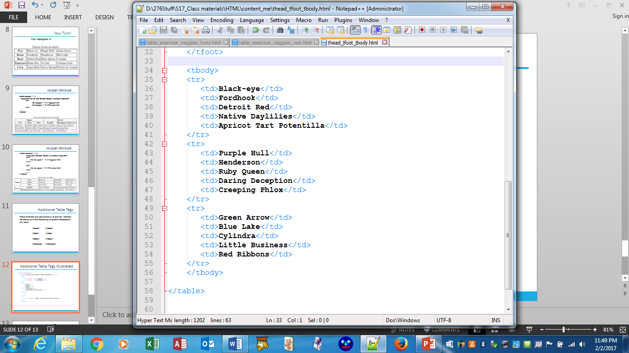
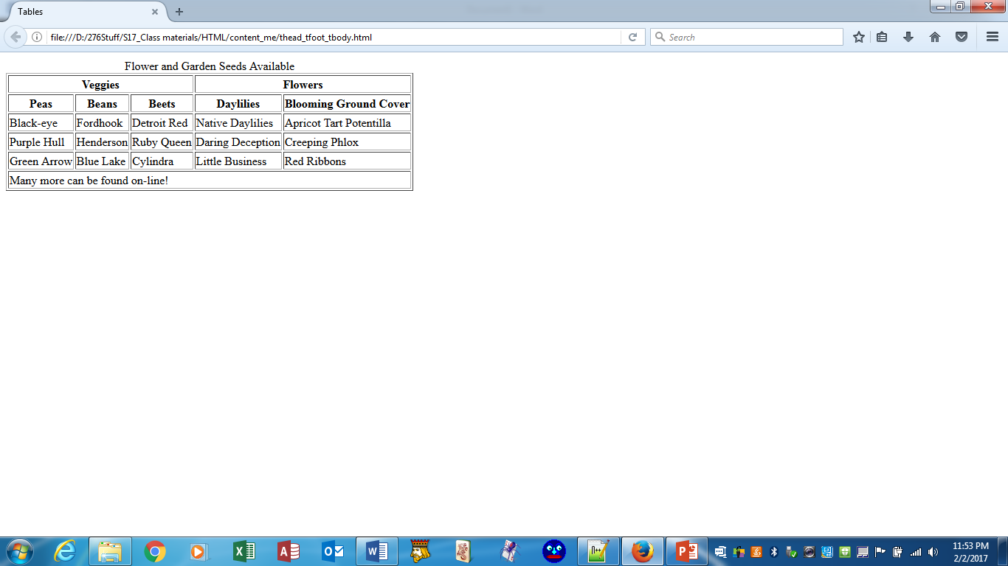
Sections Illustration

Slide 14
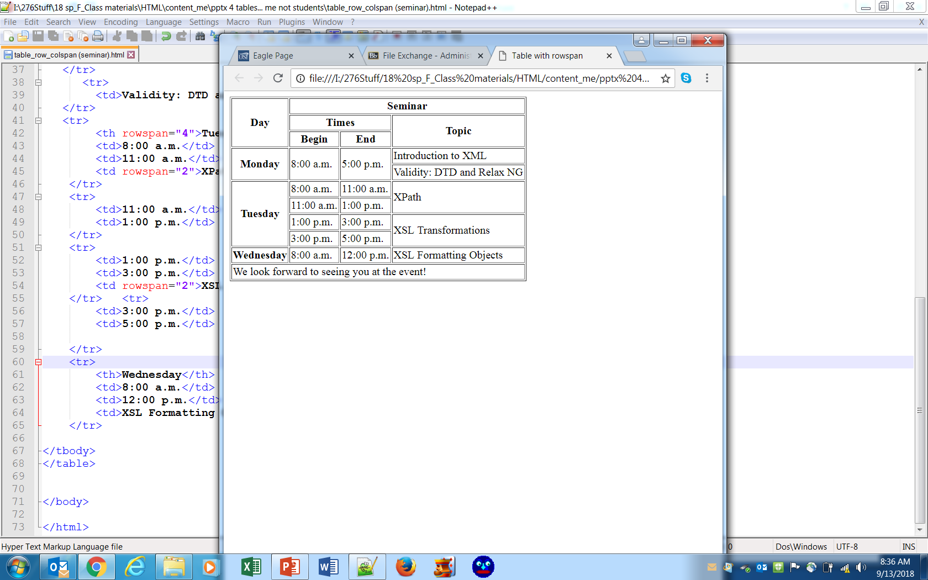
Your Turn Again!
Use sections: <head> <foot> <body>
head
body
foot

